Slide 1
Docker
Containerizing a Monolithic Application into a Microservice-based PaaS
Todd Fritz
March 11, 2015

Slide 3
Agenda
Why Containers?
Business Value
Adoption
Docker Basics
Orchestration Toolkit
Decompose the Monolith
Microservices
API Gateway
Service Discovery
Security & Networking
Putting it Together
Questions?

Slide 4
About Me
Senior Software Architect @ Altisource Labs
The opinions contained herein may not represent my employer,
but I believe they should.
Platform Development, Middleware, MoM, EIP, EDA, etc
Deployment perspective
Exposed to many environments, technologies, people
Life-long learner and always curious
Novice bass player
Scuba diver - next adventure
https://www.bikiniatoll.com/divetour.html

Slide 5
Presentations
DevNexus 2015 (today!)
http://www.slideshare.net/ToddFritz/2015-03-11_Todd_Fritz_Devnexus_2015
Great Wide Open - Atlanta (April 3, 2014)
http://www.slideshare.net/ToddFritz/2014-04-03legacytocloud
AJUG (April 15, 2014)
http://www.slideshare.net/ToddFritz/2014-april-15-atlanta-java-users-group
Video - https://vimeo.com/94556976

Slide 6
Why Containers?

Slide 7
Why Containers?
Familiarity with Docker helpful
Not Cargo Cult Programming (pun intended)
Streamline development and testing
Portable and predictable across environments
Composable and dynamic
Ideal for Microservices
Deployment
Scaling
Clocker, Apache Brooklyn, RancherOS

Slide 8
Why Containers?
More disruptive to cloud providers who have defined their own cloud deployment architectures
Does a heavy O/S get in the way?
Docker fever! Rapid innovation during past year!
Red Hat – early adopters
IBM – Q4 2014 - Enterprise Hosting for Docker
Microsoft - Q4 2014 - Azure
Amazon – Q4 2014
Digital Ocean, Joynet
Need for more standards
Blueprints, e.g. Apache Brooklyn

Slide 9
Why Containers?
Ancestry?
Jailing / BSD
Solaris Zones / Containers have been around for a long time

Slide 10
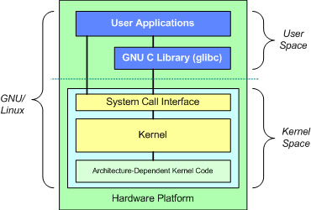
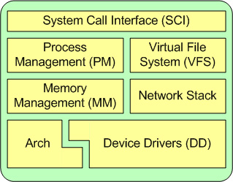
Why Containers?
Thought: a paradigm shift for the O/S?
Redefines “Kernel Space”? CoreOS, RancherOS
Redefines “User Space”?
Better fit for distributed computing
http://www.ibm.com/developerworks/library/l-linux-kernel/

Slide 11
Business Value

Slide 12
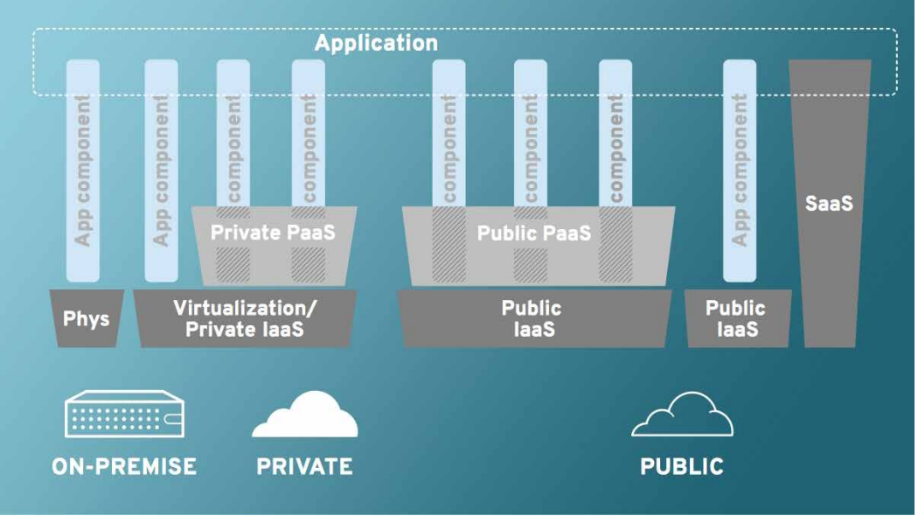
Business value
xPaaS
Decoupled, separated concerns, vendor specialization
https://img.en25.com/Web/RedHat/JB_xPaaS_Tech_Overview_11454037_v3_0913cd_web.pdf

Slide 13
Business Value
Necessary? “If it ain’t broke, don’t fix it.”
Simplifies deployment, management, administration
Enhances Architecture, Developers, Dev Ops
Speed to market with scale-up
Replaces sandboxing with containers
Reduces cost
Portable and predictable
Streamline development, QA
Scales via configuration
Emerging technologies for autonomic self-management

Slide 14
Business Value
Containers enable the “Intelligent Cloud”?
Container is basic unit
Self-scaling
Self-managing; platform intelligence reduces TCO
Self-healing
Containers/apps expose metrics and events (security)
Container manager collects metrics
Machine learning interprets metrics to identify stimuli
Platform reacts to interpreted stimuli (OPS, security)
Programmed or self-organized

Slide 15
Adoption

Slide 16
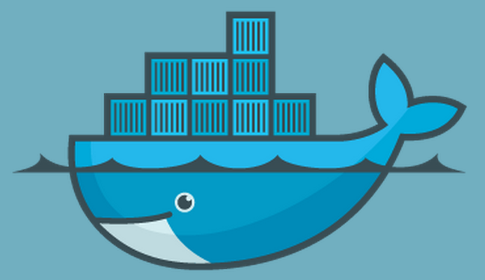
Adoption
Whale you be my container?

Slide 17
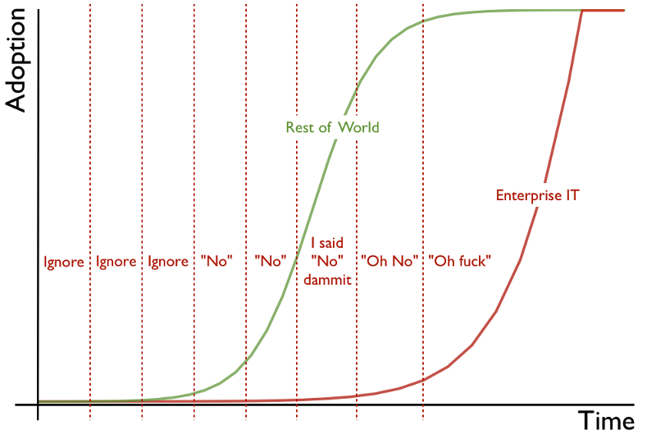
Adoption
Adoption cycle graphic © 2012 Simon Wardley and CC BY-SA 3.0
“#@$%!

Slide 18
Adoption - Obstacles
Management
Need right skills and people to pull it off
Heard it is complex with perceived security flaws
Lack of in-house technical expertise, schedule, time
Learning curve, fear of change, unable to quantify risk
How to justify the expense?
Developers, QA, DevOps
Learning curve
Need for direction and guidance
Know-it-alls or superficial, tangential decision making
Architects and Technical Leadership
Learning curve
Executive sponsorship

Slide 19
Adoption - Overcoming Obstacles
Architects
Begins with a knowledgeable evangelist
Sell to developers and articulate technical / business benefits
Involve DevOps – “Not a Chef replacement”
Mentor growth of in-house expertise
Developers / QA
Evangelize benefits to team, generate excitement, spike it
Obtain buy in, get team to sell up the chain
Try it out, be curious do a PoC!
Management
Evangelize to forward-thinkers who “get it”
Sell ROI, speed to market, benefits of good architecture
Reduces TCO of engineering and operations

Slide 20
Docker Basics

Slide 21
Docker Basics
Open-source
Easier scalability
Lightweight, portable, insulated containers
Reuse from dev (“local cloud”) through production
Can run at scale on VMs, bare metal, cloud
Encapsulate any payload - application
Run consistently including hybrid environments
PaaS enabler
Replaces sandboxing

Slide 22
Docker Basics
What is Docker?
“(…) an open platform (…) to build, ship, and run distributed applications.”
Docker Engine
“Portable, lightweight, runtime and packaging tool.”
Docker Hub Registry
“Cloud service for sharing applications and automation workflows.”
https://www.docker.com/whatisdocker/

Slide 23
Docker Basics
Docker Image
Configured Snapshot of server or service.
Can be extended
Docker Container
Docker images run within the container
DockerFile
Instructions/commands that create image

Slide 24
Docker Basics – Dockerfiles
Used to build containers by scripting creation actions of image layers
Less powerful than traditional configuration management software
Example
In discrete steps, instruct Docker to build an image by taking a default Ubuntu distro, apt-get install dependencies, and then add the application.
Each Dockerfile command creates a new image layer, and clever structuring of the commands enables reuse

Slide 25
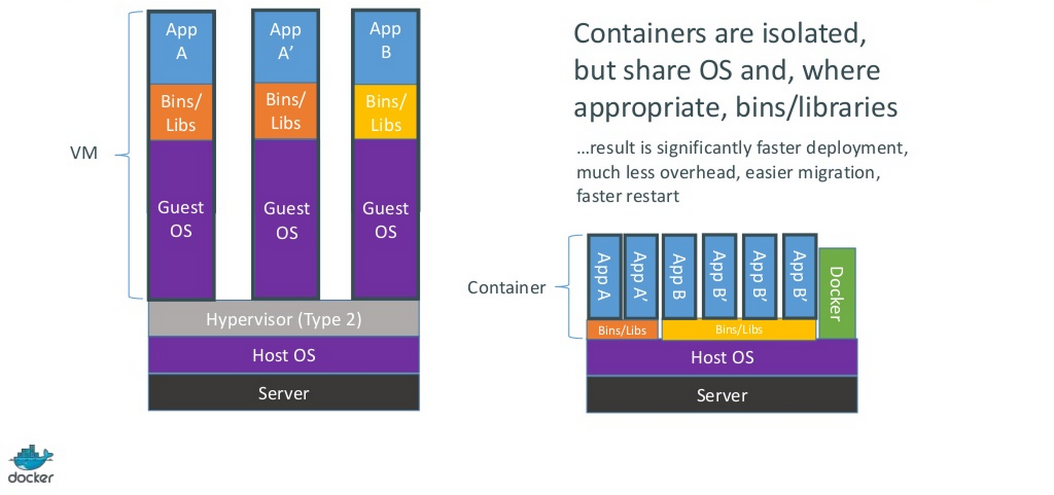
Docker Basics – Virtual Environment vs. VM
http://www.slideshare.net/dotCloud/docker-intro-november

Slide 26
Docker Basics – How, What, Why
Automates app deployment within containers
Originally based on Linux Containers (LXC) via an API to expose lightweight virtualization that:
Process isolation
Utilizes LXC, cgroups, and the kernel
Does not include a separate operating system
Kernel provides resource isolation
CPU, memory, block I/O, network
Now have libcontainer (native Go) – replaces use of LXC
Interface between user space and kernel
Works well with Chef, Puppet, Vagrant
Dynamic provisioning – ideal for PaaS

Slide 27
Docker Basics
Container is the basic building block
Analogous to a slice of a VM image, containing application code or binaries, as well as the execution environment and dependencies
Images may be built atop each other
An image contains only the incremental changes required to transform its base image to the state required by the image
May contain metadata, such as how to run what is inside the image, expose ports, etc
Acts as an instantiable container template

Slide 28
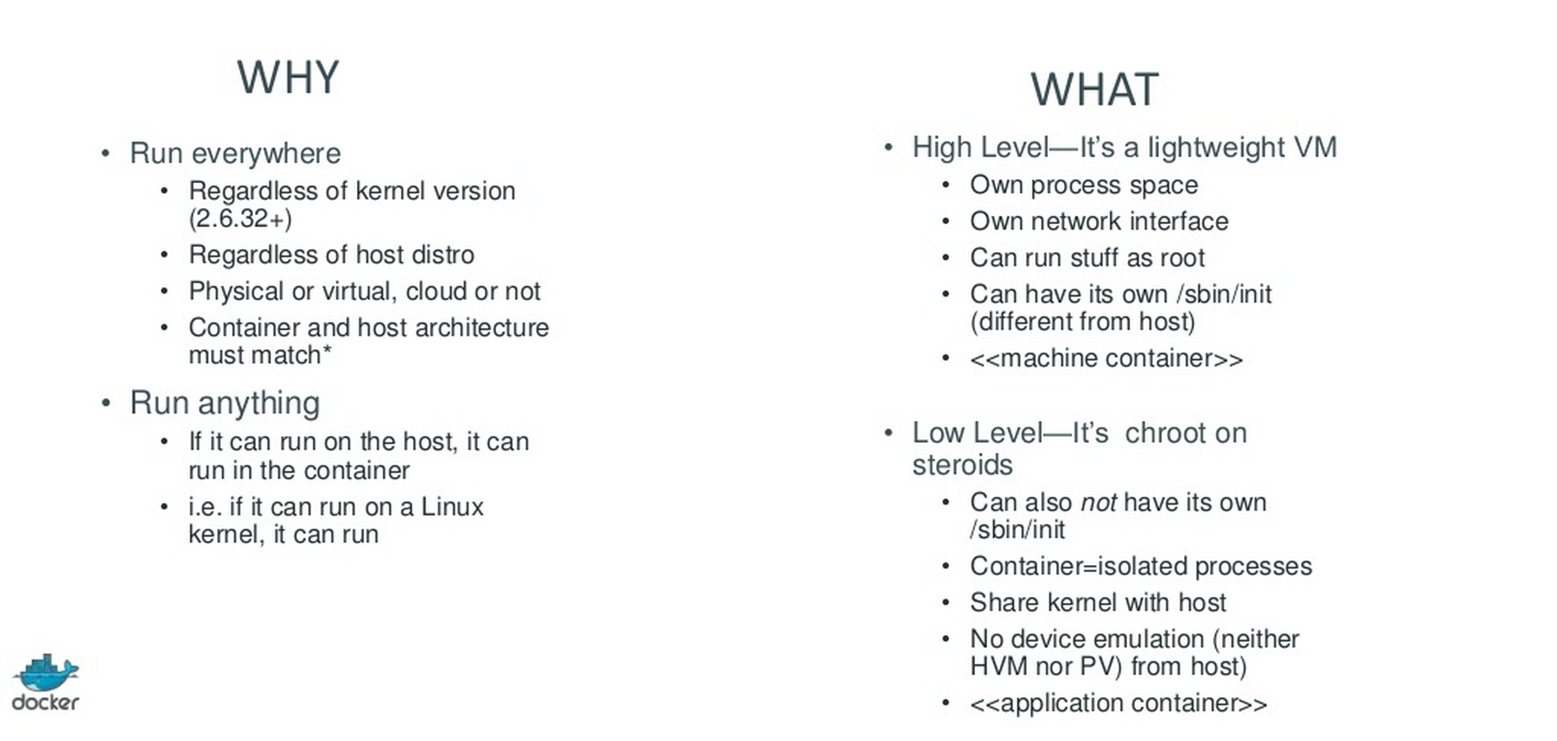
Docker Basics
http://www.slideshare.net/dotCloud/docker-intro-november

Slide 29
Docker Basics
Intra-container communication via sockets (Docker links). Containers can talk to each other.
Familiar lifecycle: started, stopped, or kill
Can create images from previously run containers, to persist changes made while container was executing

Slide 30
Docker Basics
Docker has three parts
docker daemon runs as root to manage containers
docker containers spawn from images, which are tiny and can be versioned
docker repository allows images to be exchanged and versioned like code (public or private)
Each container has a unique IP address
Port and pipework to expose containers outside host
Share volumes, multi home, integrate containers into host network (and more)
Continuous integration can generate versioned docker images, web hooks, repo notifications

Slide 31
Docker Basics
Common use cases
Automate application packaging and deployment
Lightweight PaaS environments
Automate testing, continuous integration, and deployment
Deploy and scale web apps, databases, backend services

Slide 32
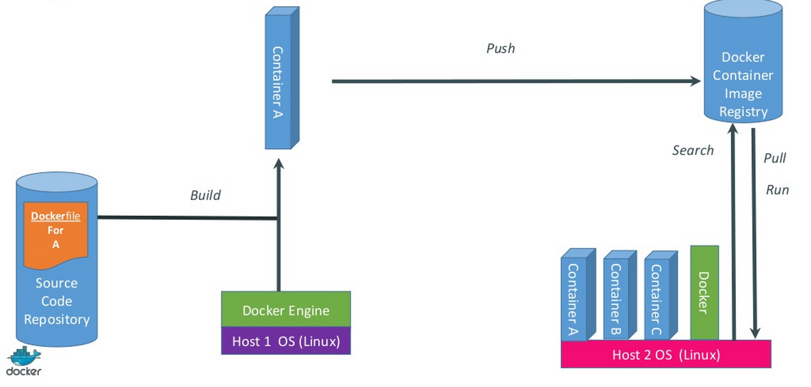
Docker Basics
http://www.slideshare.net/dotCloud/docker-intro-november

Slide 33
Docker Basics – PaaS Frameworks
Docker sold DotCloud PaaS to cloudControl
Not opinionated
Deis, Flynn
(Both provide scaffolding to support distributed, containerized, service implementations)
Opinionated
CloudFoundry, OpenShift, Apcera Continuum
Integrates Docker into their systems
CoreOS, RancherOS

Slide 34
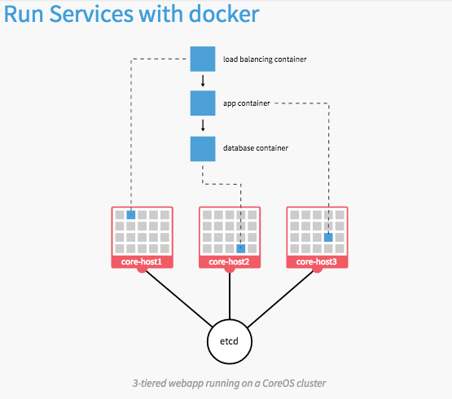
Docker Basics - CoreOS
CoreOS uses fleet to run containers with systemd
https://coreos.com/using-coreos/

Slide 35
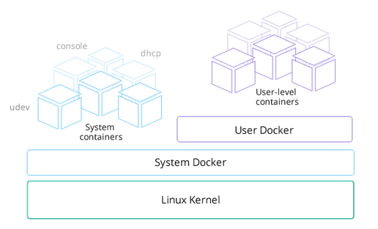
Docker Basics - RancherOS
A “System Docker” as PID1 manages “User Dockers”
Separate Docker daemon runs in User Docker container
http://rancher.com/rancher-os/

Slide 36
Orchestration Toolkit

Slide 37
Orchestration Toolkit
Portability across environments, providers
Composable
New technologies (beta), not production ready
Docker Machine
Docker Swarm
Docker Compose (based on fig)
http://www.infoq.com/news/2015/03/docker-machine-swarm-compose
Micro Virtualization to follow?
http://thenewstack.io/orchestration-toolkit-release-aims-prove-dockers-commitment-flexibility-community-ecosystem/

Slide 38
Orchestration Toolkit – Docker Machine
Docker Machine
(Separate project from Docker Engine)
Abstraction used to provision to different environments
Support for 12 environment providers
Virtualbox (local)
Digital Ocean, AWS, Azure, Vmware, and more
Hybrid environments
https://github.com/docker/machine
% machine create -d [infrastructure provider] [provider options] [machine name]
http://blog.docker.com/2014/12/announcing-docker-machine-swarm-and-compose-for-orchestrating-distributed-apps/

Slide 39
Orchestration Toolkit – Docker Swarm
Native clustering
A pool of Docker hosts exposed as a single, virtual host
Schedule containers to run atop
Automatic workload management
Uses standard Docker API
Any tool using docker daemon can Swarm transparently
Dokku, Compose, Krane, Flynn, Desi, DockerUI, Shipyard, Jenkins
Docker client
H/A and Failover
Swarm performs health checks with auto-rebalancing
Policy-based scheduling: standard and custom constraints
https://github.com/docker/swarm/

Slide 40
Orchestration Toolkit – Docker Swarm
Scheduling algorithm
Standard filters
Constraint (storage=ssd, storage=disk, etc)
storagedriver, executiondriver, kernelversion, operatingsystem
Affinity
Certain containers may perform better on same host
“Locality of Reference”
Port
Health
Even Azure cloud computing platform supports it
http://www.eweek.com/cloud/docker-swarms-onto-microsofts-cloud.htm

Slide 41
Orchestration Toolkit – Docker Swarm
Undergoing development
Adding feature to reschedule container on failed host

Slide 42
Orchestration Toolkit – Docker Swarm
# create a cluster
$ docker run --rm swarm create
6856663cdefdec325839a4b7e1de38e8 # <- this is your unique <cluster_id>
# on each of your nodes, start the swarm agent
# <node_ip> doesn't have to be public (e.g. 192.168.0.X),
# as long as the swarm manager can access it.
$ docker run -d swarm join --addr=<node_ip:2375> token://<cluster_id>
# start the manager on any machine or your laptop
$ docker run -d -p <swarm_port>:2375 swarm manage token://<cluster_id>
# use the regular docker cli
$ docker -H tcp://<swarm_ip:swarm_port> info
$ docker -H tcp://<swarm_ip:swarm_port> run ...
$ docker -H tcp://<swarm_ip:swarm_port> ps
$ docker -H tcp://<swarm_ip:swarm_port> logs ...
...
# list nodes in your cluster
$ docker run --rm swarm list token://<cluster_id>
<node_ip:2375>

Slide 43
Orchestration Toolkit – Docker Compose
Final piece of orchestration puzzle
After provisioning with Machine
After defining clustering with Swarm
Based on Fig
Define application components within one file
Containers, container configuration, links, volumes
Assemble multi-container distributed apps to run atop Swarm-managed clusters
Simple YAML configuration
https://github.com/docker/docker/issues/9694

Slide 44
Orchestration Toolkit – Docker Compose
Commands to manage lifecycle: start, stop, rebuild
Obtain status of running services or view logs
On Roadmap:
Support for test, staging, production environments
Integration with Swarm
Support for multi-team and multi-registry development
Improved container build automation (e.g. auto C.I.)
https://github.com/docker/compose/blob/master/ROADMAP.md#applications-spanning-multiple-teams

Slide 45
Orchestration Toolkit – Docker Compose
containers:
web:
build: .
command: python app.py
ports:
- "5000:5000"
volumes:
- .:/code
links:
- redis
environment:
- PYTHONUNBUFFERED=1
redis:
image: redis:latest
command: redis-server --appendonly yes

Slide 46
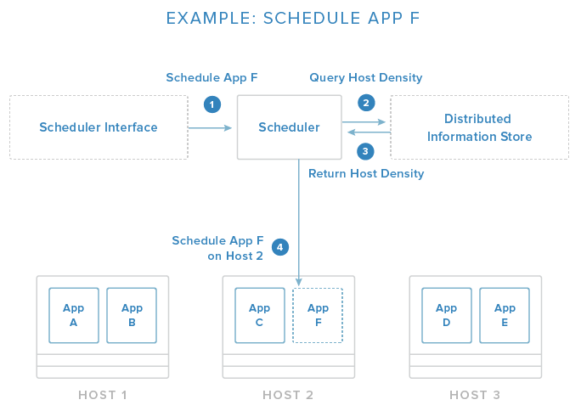
Orchestration Toolkit - Schedulers
Schedulers are responsible for starting containers on available hosts.
https://www.digitalocean.com/community/tutorials/the-docker-ecosystem-an-introduction-to-common-components

Slide 47
Orchestration Toolkit - Schedulers
Options
Fleet
Marathon
Swarm
Kubernetes
Compose

Slide 48
Decompose the Monolith

Slide 49

Decompose the Monolith
So, you have a monolithic app that needs to be modernized… For whatever reason.
How to rebuild it? (insert: Six Million Dollar Man ref.)

Slide 50
Decompose the Monolith
No smoking in the Emergency Room!
System Analysis
Use an iterative methodology
Leverage existing knowledge and literature
Some analysis before
Decompose and modularize (scale cube)
Separation of concerns
Proof of concepts are your friend

Slide 51
Decompose the Monolith
A simple metaphor to follow
(Please do not leave)

Slide 52
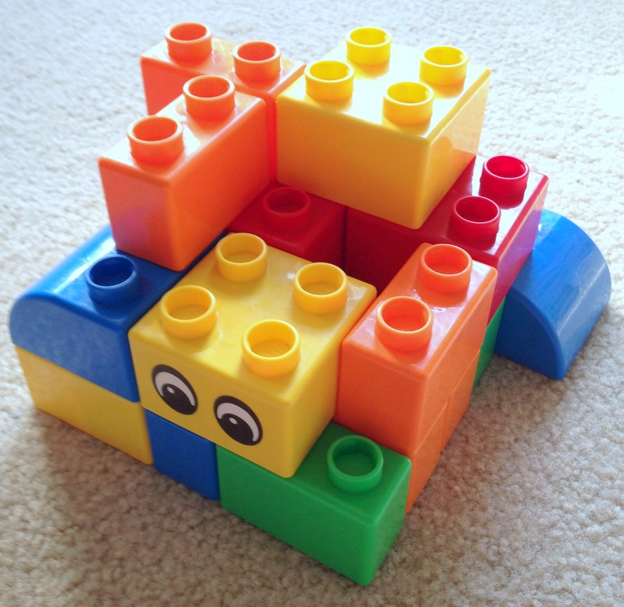
Decompose the Monolith
I’m a proud stovepipe, just bolted together, vroom vroom vroom vroom vroom.

Slide 53
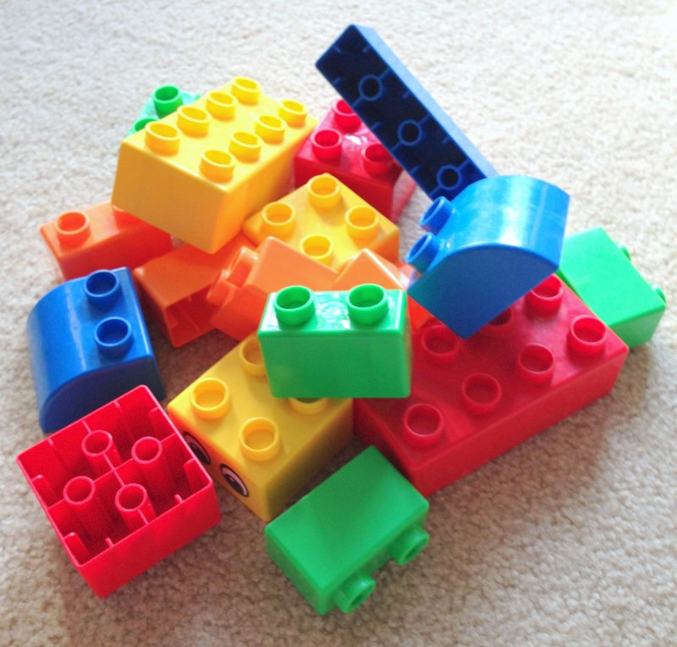
Decompose the Monolith
Oh, nooo... My job security...

Slide 54
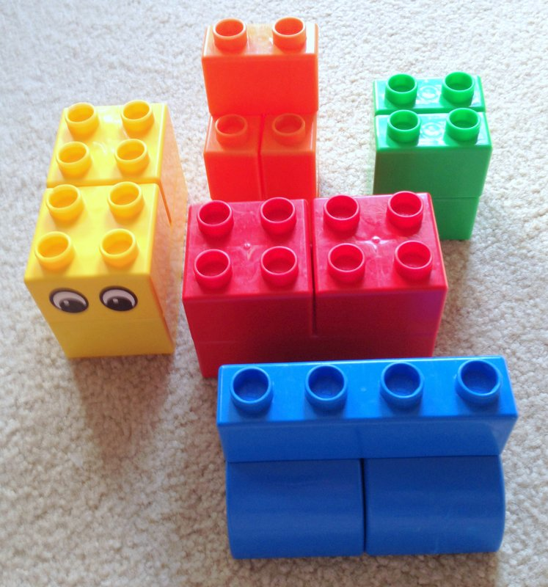
Decompose the Monolith
I now have free nights and weekends...

Slide 55
Decompose the Monolith - Technique
“Bounded Context” from Domain-Driven Design
Identify discrete business capabilities (“Functions”)
Functions govern part of enterprise data model
A Microservice implements a Function
Microservices encapsulate data access via API (REST)
Data store per microservice (no sharing)
Overlap managed by higher-order microservices or hypermedia
Functions may share – e.g. “Addresses”
Also consider the “Scale Cube”
http://microservices.io/articles/scalecube.html

Slide 56
Microservices

Slide 57
Microservices
Why?
Good fit for containers
Ideal for distributed computing
Correct implementation is hard
A warning
http://highscalability.com/blog/2014/4/8/microservices-not-a-free-lunch.html
The ESB from yesterday does not fit
https://www.voxxed.com/blog/2015/01/good-microservices-architectures-death-enterprise-service-bus-part-one/
Once upon a time, Enterprise Application Integration (EAI)
SOA emerges, vendors rebrand EAI offerings as ESBs
Old ESBs were centralized → new ESBs decentralized

Slide 58
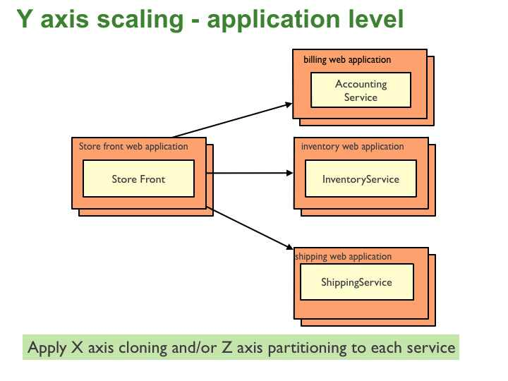
Microservices
Various definitions (sometimes a “Holy War”)
Why Microservices?
Because building monoliths is so 2005…
What runs in the container, matters
http://microservices.io/patterns/microservices.html
Architecture for delivery of systems as a set of services
Small
Collaborating
Independent

Slide 59
Microservices – tenets – SOLID
Single Responsibility Principle (SRP)
“One reason to change”
Open-Closed Principle (OCP)
Open for Extension, closed for modification
Swappable implementations behind API, Polyglot persistence
Liskov Substitution Principle (LSP)
Implementation honors API contract
Interface Segregation Principle (ISP)
Clients should not be forced to implement unused methods
“Fat Interfaces”
Dependency Inversion Principle (DIP)
Abstractions should not depend upon details. API GATEWAY.
http://www.mattstine.com/2014/06/30/microservices-are-solid
http://www.mattstine.com/2014/06/30/microservices-are-solid

Slide 60
Microservices – Advantages
Familiar concept? SOA without the ESB?
Simple services, focused on doing one thing (well)
Loose coupling
Facilitates parallel development; multiple teams
Easier to test
Enables C.I. / C.D.
Decouple technology and tooling from service
Use what you want to implement (polyglot)

Slide 61
Microservices – Disadvantages
Complexity of distributed system
Operationalization overhead
Each service needs load balancing, monitoring,
Testing distributed systems is hard
Deployment complexity; DevOps skill
Implicit Interfaces between collaborating components
Backwards compatibility quicksand
Some duplication of effort
http://highscalability.com/blog/2014/4/8/microservices-not-a-free-lunch.html

Slide 62
Microservices – Best Practices
Separate data store per microservice
Similar level of code maturity
Separate build, CI per microservice
Containerize!
Stateless!
http://nginx.com/blog/microservices-at-netflix-architectural-best-practices/

Slide 63
Microservices
Google gRPC
http://www.infoq.com/news/2015/02/grpc

Slide 64
API Gateway

Slide 65
API Gateway
Two peas in a pod
API Gateway & Microservice Architecture
API Gateway acts as single point of entry into Microservice architecture for a client
Serve different types of clients
Protocol Translation, etc (EIP – Camel)
http://techblog.netflix.com/2013/01/optimizing-netflix-api.html
Handles requests in two ways
Proxy/routing to service
Fan-out to multiple services

Slide 66
API Gateway
Benefits
Decouples clients from services
Improves client’s API experience
Abstract logic for orchestrated services into gateway
Reduces request/response round trips
Disadvantages
More complex
Possible increase in latency (network hop through gateway)
http://microservices.io/patterns/apigateway.html

Slide 67
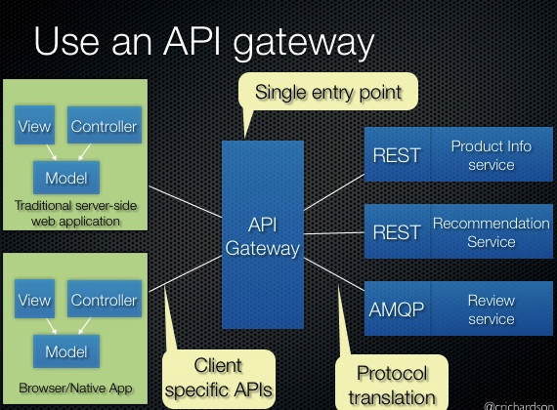
API Gateway
http://microservices.io/patterns/apigateway.html

Slide 68
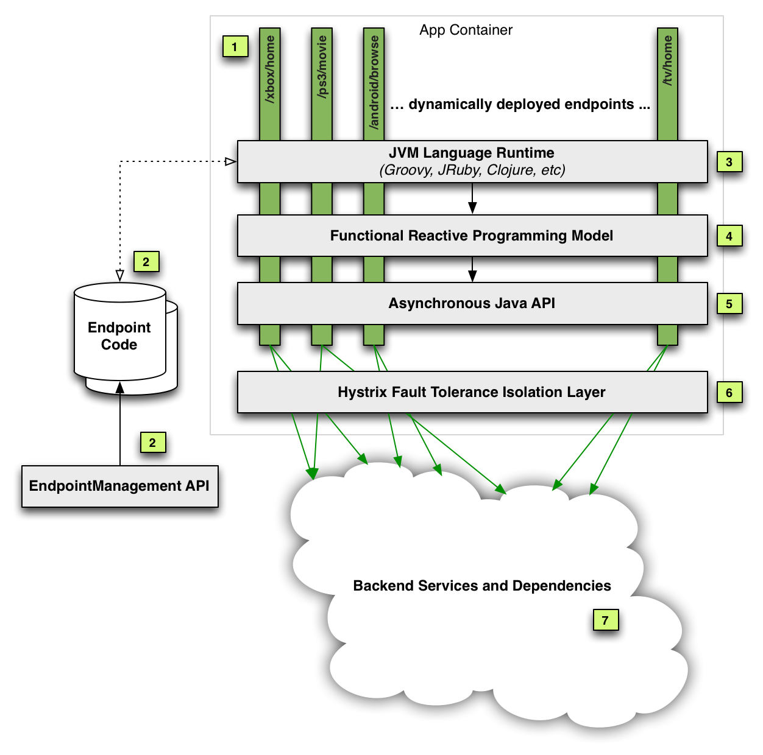
API Gateway – At Netflix
Dynamic Polyglot Runtime
Fully Synch Service Layer
Reactive Programing Model
http://techblog.netflix.com/2013/01/optimizing-netflix-api.html

Slide 69
Service Discovery

Slide 70
Service Discovery
Service Discovery requires a Service Registry
Apps need need to register exposed services
Clients lookup, bind, invoke
Applications then query discovery service for how to connect to an application
Responsibilities
Provide clients with metadata to connect to service
Allow applications to register to provide #1
Expose global location to start arbitrary configuration
Store metadata about cluster members

Slide 71
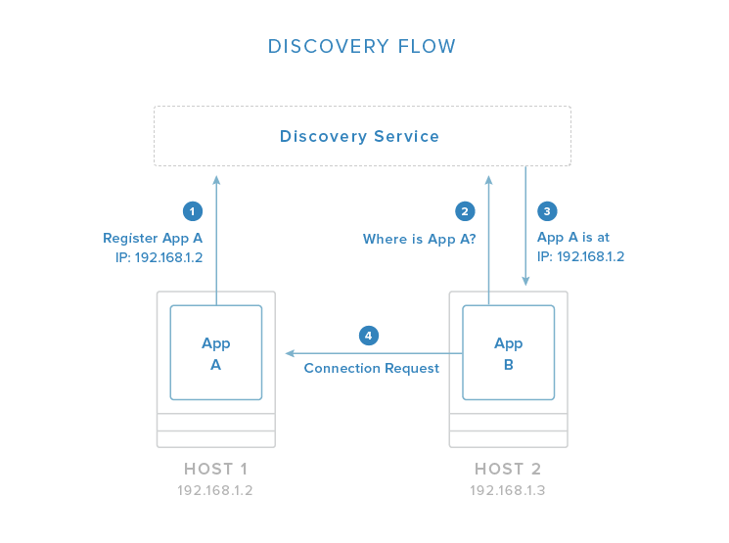
Service Discovery
https://www.digitalocean.com/community/tutorials/the-docker-ecosystem-an-introduction-to-common-components

Slide 72
Service Discovery
Popular service discovery tools
Etcd
Created by CoreOS. HTTP API and a CLI.
Consul
“Advanced features”: health checks, ACL, HAProxy config
Zookeeper
Older and lacks new features, but more stable and mature

Slide 73
Service Discovery
Value adds
Crypt
Components can use keys to protect information
Clients can read if they have decryption key
Confd
Dynamic reconfiguration of apps
Vulcand
Load balancer. “Etcd aware”
Marathon
Scheduler and basic HAProxy config management
Nerve
Used with Synapse for health checks and auto cluster mgmt

Slide 74
Service Discovery – Fibers > Asynch?
Alternatives to Asynch?
Why deal with the heaviness?
Lightweight threads and Actors for JVM
Quasar
https://github.com/puniverse/quasar
Lightweight threads, Go-like channels, Erlang like actors, etc
COMSAT
https://github.com/puniverse/comsat
Scalable, concurrent web-apps
Not Web Framework
Implementations to popular (and standard) APIs, including JAX-RS, JDBC, Servlet, etc – that are called with Quasar fibers
https://www.voxxed.com/blog/2015/02/farewell-to-asynchronous-code/

Slide 75
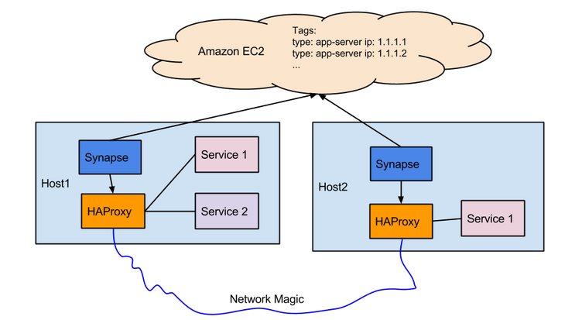
Service Discovery – Clay.io example
http://zolmeister.com/2015/02/10x-service-discovery-at-clay-io.html
http://zolmeister.com/2014/12/10x-docker-at-clay-io.html

Slide 76
Security and Networking

Slide 77
Security and Networking
Very hot topic
Ongoing investment and innovation
Docker adds security experts to team
Announced last week
Docker acquires SocketPlane
Announced last week
3 months from startup to acquisition? A record?
Native to Docker
Software defined network services
For distributed applications that span hybrid clouds
http://www.programmableweb.com/news/docker-extends-api-reach-socketplane-acquisition/2015/03/05

Slide 78
Security and Networking
Swarm
TLS AuthN between CLI and Swarm
TLS between Swarm and Docker nodes
Containers weaker than VM for isolation
VM’s can use ring-1 hardware isolation
Prevents VM’s from “breaking out”
Containers lack hardware isolation
“Shocker” attack (for pre 1.0 Docker containers)
Running atop hypervisor enhances resource isolation but does not necessarily make this more secure
Container in VM reduces surface area for attacks
Don’t do stupid stuff in container, follow best practices

Slide 79
Security and Networking
“When we feel comfortable saying that Docker out-of-the-box can safely contain untrusted uid0 programs, we will say so clearly”
- Docker CTO Solomon Hykes

Slide 80
Security and Networking
Networking capabilities somewhat limited
libchan is officially sponsored approach
Go like channels over network
Flocker
Proxy based approach
Host-portable services (including underlying storage)
Weave
Powerstrip
Use Weave and Flocker together
Run a Crate cluster using Weave’s container networking and portable storage provided by Flocker

Slide 81
Security and Networking
OpenVswitch
https://github.com/openvswitch/ovs
Multilayer software switch (VM environments)
Standard control and visibility interfaces
Designed for distribution across multiple servers
Security companies not yet offering container endpoint protection
Lack of tools for encryption at container level
Lacks live migration tools

Slide 82
Putting it Together

Slide 83
Putting it Together
“Without Paas, Docker is just a bunch of containers.”
http://www.zdnet.com/article/paas-and-docker/
Needs supporting technologies
Gaps
Underserved: networking, storage, granular versioning
Apache Mesos for simpler clustering?
http://www.zdnet.com/article/why-amazons-docker-service-is-linking-into-apache-mesos-for-simpler-clustering/

Slide 84
Putting it all Together
How to put a solution together?
Clocker (from Cloudsoft)
Create Docker clouds orchestrated by Apache Brooklyn
Single to multi host
Intelligent container placement: resilience, scaling, fault tolerance, resource optimization
Existing Brooklyn/CAMP blueprints port without change
Apache Brooklyn
jClouds API (cloud API agnostic) for provision
Monitors and manages containers
Configuration blueprints that use docker infrastructure
Uses Dockerfiles
http://thenewstack.io/an-open-source-story-clocker-does-what-docker-cant-do-alone/

Slide 85
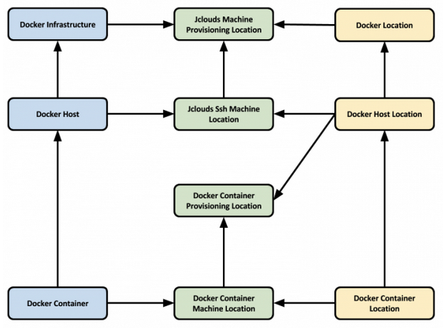
Putting it Together

Slide 86
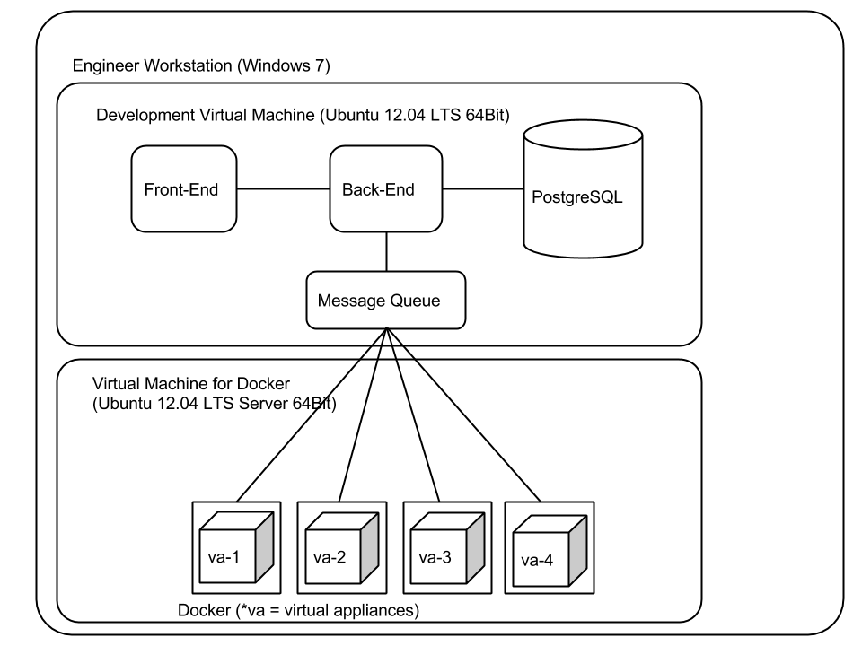
Putting it Together
http://www.appneta.com/blog/automated-testing-with-docker/

Slide 87
Putting it Together
Not part of this presentation
Worth reading
Apache Samza
http://blog.confluent.io/2015/03/04/turning-the-database-inside-out-with-apache-samza/

Slide 88
Appendix

Slide 89
Trends & Innovation
Hardware
“Quantum” processors – Qbits
Input, Output, Memory, CPU, Network
Software
Machine Learning, Artificial Intelligence
Autonomous systems
Self-Tuning -> Self-Improving -> Self-Coding
Manufacturing
3D printing
A.I. managed hardware provisioning and “data center” construction”. On-premise construction?
Within 50 years, the Singularity?

Slide 90

Questions?

Slide 91
Resources
http://highscalability.com/blog/2014/4/8/microservices-not-a-free-lunch.html
https://medium.com/aws-activate-startup-blog/using-containers-to-build-a-microservices-architecture-6e1b8bacb7d1
http://codesamplez.com/web-server/dockerize-an-application-from-scratch
http://blog.docker.com/2014/12/announcing-docker-machine-swarm-and-compose-for-orchestrating-distributed-apps/
http://www.infoq.com/articles/docker-future
https://crate.io/blog/crate-flocker-weave-powerstrip-snowsprint/
https://coreos.com/using-coreos/
http://rancher.com/announcing-rancher-io-portable-infrastructure-services-for-docker/
http://nginx.com/blog/microservices-at-netflix-architectural-best-practices/
http://zolmeister.com/2015/02/10x-service-discovery-at-clay-io.html
http://zolmeister.com/2014/10/10x-architecture-at-clay-io.html
http://zolmeister.com/2014/10/10x-logging-at-clay-io.html

